Slide 1




Adults at risk of exploitation:
Putting the pieces of the jigsaw together
Monique Lhussier: Professor in Public Health and Wellbeing, Northumbria University
Kerry Cooke: Safeguarding Adults Manager, Newcastle City Council
Acknowledgements to the NHIR arc for funding the research and Newcastle City Council and Northumbria University and all the individuals who took part in the study.

Slide 2

What does exploitation look like?
Exploitation involves exploitative situations, contexts and relationships where someone receives something (e.g. food, accommodation, drugs, alcohol, cigarettes, affection, gifts, money) because of them completing a task on behalf of another individual or group of individuals.
Perpetrators will often target young or vulnerable adults in order to exploit them, praying on their vulnerabilities and then using this against them in order for the perpetrator to gain control of the victims actions.
Handling/Storage of stolen goods
Criminal Exploitation
Modern Slavery
Forced Drug Dealing
Financial Exploitation and Debt Bondage
Home takeover (cuckooing)
Sexual Exploitation
County Lines
Notes:
Explain different types of exploitation that occur for children and adults
Exploitation involves exploitative situations, contexts and relationships where someone receives something because of them completing a task on behalf of another individual or group of individuals.
Perpetrators will often target young or vulnerable adults in order to exploit them, praying on their vulnerabilities and then using this against them in order for the perpetrator to gain control of the victims actions.
Some types of exploitation can include:
Criminal Exploitation
Sexual Exploitation
Home takeover (often referred to as cuckooing)
County Lines
Modern Day Slavery
Forced Drug Dealing
Financial Exploitation and Debt Bondage
Handling/Storage of stolen goods
“exploitation” is an umbrella term which encompasses a range of different forms of abuse, neglect and criminal offences under modern slavery and human trafficking. We understand that there are lots of different terminology used in this context, however we felt that the term exploitation was more widely understood by practitioners and others.
These terms might be used interchangeably:
Modern Slavery
The recruitment, movement, harbouring or receiving of children, women or men through the use of force, coercion, abuse of vulnerability, deception or other means for the purpose of exploitation.
This is a Crime under the Modern Slavery Act and includes holding a person in a position of slavery, servitude forced or compulsory labour, or facilitating their travel with the intention of exploiting them soon after. It is also a form of abuse specifically listed within the Care Act as a category of abuse under safeguarding adult duties.
Human trafficking
Human trafficking is the process of recruiting and transporting people through deception or coercion for the purpose of exploitation. It is a common misconception for people to think trafficking only happens across international borders when in fact, people can be moved between streets, within a town, between regions or between countries. According to Palermo Protocol, human trafficking involves three elements: the act (recruitment, transport, transfer, harbouring and the receipt of persons), the means (threat or use of force, coercion, abduction, fraud, deception and abuse of power or vulnerability), and the purpose (exploitation). All 3 components must be present for an adult to be considered trafficked. However, as regards children, the ‘means’ component is not required as they are not able to give consent.
Exploitation
when a child or adult is controlled by an abuser for the abusers own advantage;
the abuser might use coercion, intimidation, violence (including sexual violence) and weapons to do so.
Ultimately whatever term is used, it is abuse and it is something we’ve all got a responsibility to identify and respond to
We have seen an increase in referrals in Newcastle in relation to exploitation – in particular criminal exploitation and home takeover
When considering exploitation we also need to be mindful that people we perceive to be perpetrators, can still be victims themselves, there may be a chain of command or hierarchy within a group with exploitation taking part on different levels.

Slide 3
Who is at risk of exploitation?
Involved in Crime
Young
Care Leavers
Physical or Mental illness
Learning Disability / Difficulty
Addictions
Poverty
Unemployed
Lack of support networks
Anyone could be vulnerable – try not to make assumptions
Vulnerabilities
Notes:
Task: ask participants to identify what vulnerabilities might make someone more vulnerable to exploitation? Whole group exercise – participants calling out.
Click three times to reveal some key vulnerabilities and message about anyone being vulnerable.
Perpetrators are very skilled at identifying those who are vulnerable to exploitation, those who might be struggling financially, those who have a drug or alcohol dependency, people who are lonely or isolated, those leaving care, people who might have a learning disability or difficulty and those with a physical or mental illness. There are lots of links to people who have had Adverse Childhood Experiences (ACE’s), bereavement and trauma.
Ultimately though anyone could be at risk, and we should not presume someone could not be a victim of exploitation just because of their background – e.g. there have been examples of victims coming from stable families with strong supportive networks.
TALK about IMPACT ON COMMUNITIES FAMILIES, SERVICES

Slide 4
The legislative and policy context
Modern Slavery Act 2015
Care Act 2014
Crime and Disorder Act 1998
Police, Crime, Sentencing and Courts Act 2022
A lot more clarity and direction around child exploitation.
Role of...
Community Safety Partnerships?
Safeguarding Adults Boards?
Violence Reduction Units?
Notes:
So, do we get any help from legislation or statutory guidance in terms of what we should be doing about adult exploitation – not much but there is a lot of cross-over at a strategic level. The issue cuts across a number of existing strategic multi-agency partnerships and bodies. It is of relevance to Community Safety Partnerships, Safeguarding Adult Boards and in areas that have them Violence Reduction Units.
The Care Act 2014 includes modern slavery and sexual exploitation as types of abuse that should be covered by safeguarding adults arrangements, both strategically and operationally. In fact the Care Act says that we should not be constrained in our view of what abuse is – so exploitation of adults with care and support needs is definitely the business of adult safeguarding.
Section 6 of the Crime and Disorder Act requires the responsible authorities (commonly referred to collectively as a Community Safety Partnership (CSP)) in a local government area to work together in formulating and implementing strategies to tackle local crime and disorder in the area
And more recently, the Police Crime Sentencing and Courts Act 2022 introduced the Serious Violence Duty with the flexibility for local areas to take account of their evidence-based strategic needs assessment when defining serious violence 'they can include in their strategy actions which focus on other related types of serious violence, including (but not limited to) criminal exploitation, modern slavery'
So overall, no clear direction at a national level around whose responsibility it is to lead strategic arrangements around modern slavery and human trafficking. So that means efforts at a local/regional/sub-regional are often different.
Different areas will need to work out where adult exploitation best fits strategically and operationally.

Slide 5

Newcastle’s Approach
- 10 years experience
- Use of safeguarding procedures both operationally and strategically-sub committee
- Dedicated exploitation roles in adult safeguarding
- We are considered as an area of best practice nationally
- We were first to be recognised nationally for all age exploitation
- Awards – Adult social work team of the year gold award 2017
- Our interpretation of adult at risk criteria
- Dedicated safeguarding adults unit and MASH
- Partnership working- regional exploitation meetings
- Recognition of transitions

Slide 6
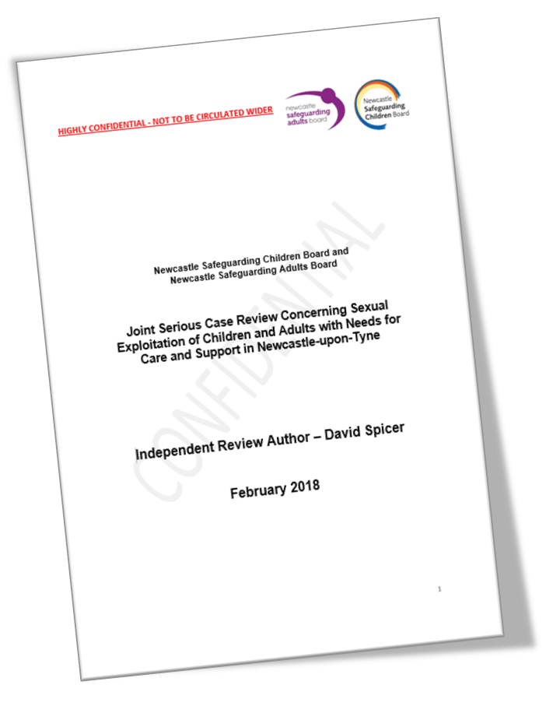
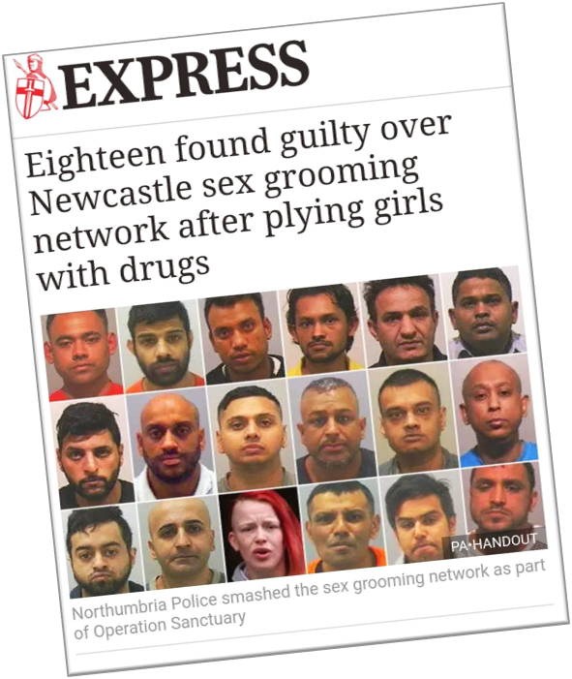
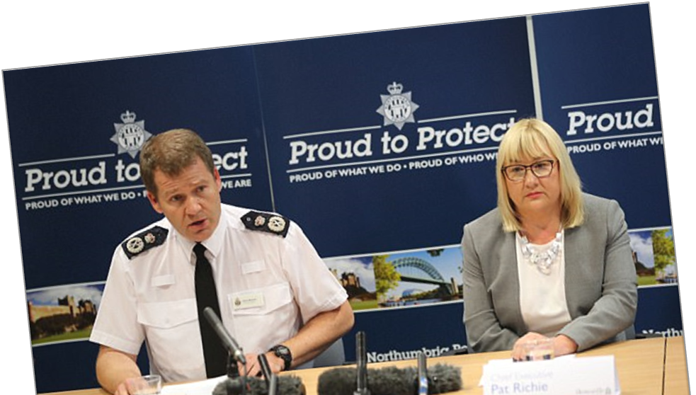
Operation Sanctuary – the way we work and why
  Joint Serious Case Review
  Exploitation involves adults too
  “Effective safeguarding is a collective responsibility and requires a culture of robust interagency and professional challenge of practice and strategy.”
Notes:
over Christmas 2013, a 21-year-old woman who has a learning disability began to speak to her social worker about experiences of sexual exploitation. With encouragement, support and great courage, in January 2014 she gave a statement to the police in which she detailed her abuse and concerns about other children and young people. She identified places to which she had been taken. This account and other intelligence gathered by the police suggested the extent of sexual exploitation meant that we needed a strategic, well-resourced, victim focussed multi-agency response. A police-led multiagency investigation, Operation Sanctuary, was launched in January 2014. Newcastle Safeguarding Children Board and Newcastle Safeguarding Adults Board provided interagency strategic commitment and there was strong political support. From day 1 we had to think about our response from a multiagency perspective. Through out we used our multi agency sGA procedures – with the key focus on making safeguarding personal.
The investigation ended with 17 men, one woman convicted for 180 years – the story though does not end for the people impacted and their families, the efefcts may be life long & we are still providing support. Indeed we need to be vigilant from an adult safegaurding view point that harms & abuse do not comtinue – we often find they do.
There was a decision taken to undertake a Serious Casr Review – this was held jointly with CSC.
Agencies were asked to review their involvement in eight cases. These were selected from a large number to maximise learning, reflect the different circumstances in which victims had suffered sexual exploitation and include factors likely to be present in other cases. They included circumstances where:
• The sexual exploitation began and ceased when they were children;
• The sexual exploitation began when they were children and continued into adulthood;
• The sexual exploitation began after they became adults but the overall police operation involved over 100 children and adults.

Slide 7
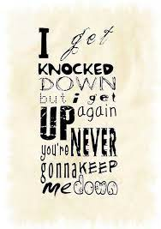
What has worked strategically for us…
A strong strategic approach leads to successful front-line responses
Engagement with senior leaders, including politicians
Dedicated sub-committee of the Newcastle Safeguarding Adults Board (NSAB) and Newcastle Safeguarding Children Partnership (NSCP)
Built on existing structures, experience and knowledge
Safeguarding Adult Board (SAB) Strategic Annual Plan – includes priorities and actions in this area
Links to other strategic bodies
Using learning from Safeguarding Adults Reviews (SARs) to influence change
Notes:
You need buy-in from senior leaders to ensure you have robust and successful front-line responses to adult exploitation. Our abilty to be creative was key
In Newcastle we had the lever of Op Sanc, briefing at CX and equivalent level, ensuring adults were represented and in the room too. Then came the Joint Serious Case Review and it’s recommendations which again gave weight to our arguments about ensuring any strategic or operational responses included adults.
Buy-in at a strategic level can also mean additional resources even in the current challenging climate – VRU temporary funding for a worker dedicated to adult exploitation work, SPOC (Team Manager) for Adult Exploitation, Social Worker for Adult Exploitation.
We have a sub-committee of our SAB jointly with our colleagues on the Safeguarding Children Partnership which focusses on exploitation – I will cover this sub-committee in more detail on the next slide.
Generally we have used existing structures, groups and relationships and further developed these to include adult exploitation.
To this day we continue to ensure that at a strategic level, adult exploitation is up there. Our Strategic Annual Plan has included actions/priorities around exploitation for the last few years – this year it is about us understanding the Serious Violence Duty and it’s implications for us in the adult safeguarding world.
You need to have the links with other strategic bodies to ensure there is joined up thinking and duplication is avoided.
Learning from SARs – we had the Joint SCR and an Appreciative Inquiry both involving exploitation – if you don’t have a SAR or similar, there are numerous SARs on the National SAR Library involving exploitation in it’s various guises and I’m going to come onto talk about some of the recurring learning from those reviews. We are also re-escalating the national issues identified in the JSCR jointly with colleagues on the Teeswide SAB (and their Molly SAR) to try and get some national traction on adult exploitation.
Hard work and challenging, not perfect, still evolving/learning/campaigning. You need passionate people and be prepared to have to jump a lot of hurdles and fall down – don’t give up.

Slide 8

Section 42 enquiries
42 Enquiry by local authority
(1)This section applies where a local authority has reasonable cause to suspect that an adult in its area (whether or not ordinarily resident there) —
  (a)has needs for care and support (whether or not the authority is meeting any of those needs),
  (b)is experiencing, or is at risk of, abuse or neglect, and
  (c)as a result of those needs is unable to protect himself
  or herself against the abuse or neglect or the risk of it.
(2)The local authority must make (or cause to be made) whatever enquiries it thinks necessary to enable it to
decide whether any action should be taken in the adult’s case (whether under this Part or otherwise) and, if so, what
and by whom.
LGA/ADASS Making Decisions on the duty to undertake enquiries
The promotion of Wellbeing (also known as the Wellbeing Principle) is the principle duty of the Care Act 2014. Every action taken, function performed or decision made by the Local Authority both corporately and operationally must give demonstrable regard to the impact upon the person's Wellbeing.
Notes:
Remind people what the s42 criteria is. Why we use it. Objectives of an enquiry and wellbeing principle and care act says about transitions
Talk about adults falling outside of the s42 criteria but we have found adults experiencing exploitation do fit this criteria
Undiagnosed needs, trauma, cognitive difficulties, neurodiversity, MH
How we interpret SGA applying not to those who need commissioned support to meet care needs

Slide 9
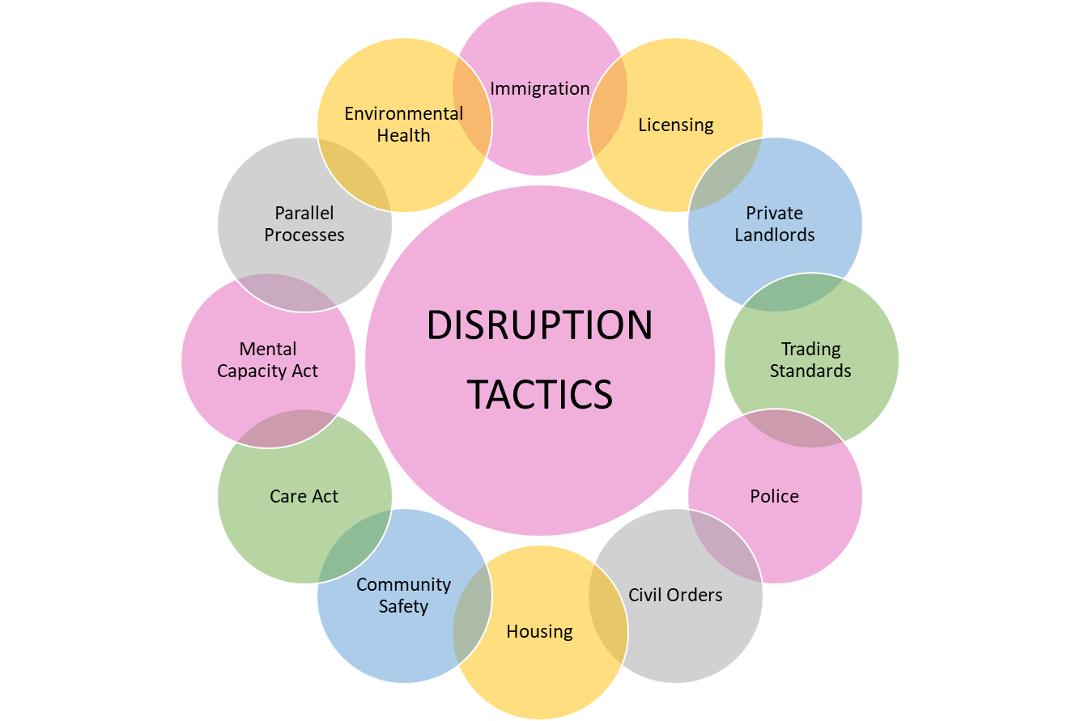
DISRUPTION and PARALLEL PROCESSES
Child, adult, others at risk
Location
Perpetrators
Notes:
Parallel process and NRM
Contextual approach
Who is at risk, who may be affected-curious re locations, names addresses, intel, monitoring. Which agency can disrupt
What other processes do we have-where does concern best sit for management

Slide 10
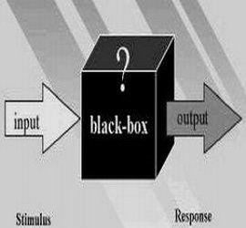
Method – Realist evaluation
~ It is not interventions/programmes or services that ‘work’. They offer resources to subjects. And it is the subjects choosing to act on these resources that determine whether the intervention works. Their choices, of course, are always constrained by wider social circumstances surrounding the programme.
Notes:
This enabled us to go beyond establishing the effectiveness of the Newcastle model, to draw more generalisable learning.
Realist evaluation attends to the ways that interventions may have different effects for different people
Develop the ideas and assumptions underlying how, why and in what circumstances complex social interventions work and they are the units of analysis used within realist evaluation.
Initial programme theories are developed, refined and then tested through empirical data, leading to the formulation of refined programme theories.
This allows for the generation of rich, causal explanations to convey ideas
This results in contextually dependent theories which are specific enough to enable testable propositions, and sufficiently generalisable, to apply in different settings in order to allow for this learning to benefit other areas.

Slide 11
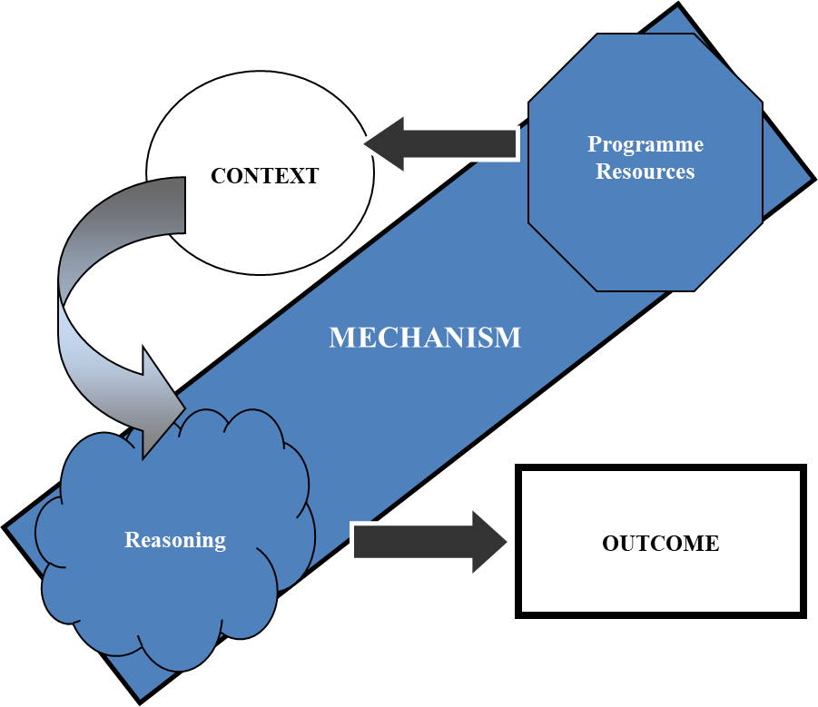
Contexts – Mechanisms - Outcomes
60 Interviews
58 case record reviews
2457 exploitation referral reviews
Notes:
Review of exploitation safeguarding referrals from November 2020 to Feb 2022
In depth review of 58 cases of closed exploitation safeguarding enquiries
A total of 60 interviews were conducted with A@R and family members, professionals and policy makers these were employed through the Local Authority, from children and adult social care and safeguarding, housing, neighbourhood and protection teams, and public health. Other partner organisations included voluntary agencies, health, substance misuse services, care providers, police, probation, and social housing.
10 participants were either adults or family members with experience and knowledge of exploitation, safeguarding and services in Newcastle. 10 participants were professionals at a senior level and 40 participants were at an operation level. It was important to have views from various levels of seniority in organisations, to understand decision making at organisational, inter-organisational levels, as well as an individual level.
Semi structured interviews were conducted with professionals at an operational and strategic level, covering their understanding of adult exploitation, and the legal tools at their disposal to counter it.
KC has a key role in adult safeguarding procedures in Newcastle, and thus participants were recruited using a snowball technique through their existing extensive networks.
Vignette case studies were developed to help A@R and family members (A@R&F) with experience of exploitation and safeguarding to express their opinions and share their understanding without having to delve into their personal experiences.
Semi structured interviews were conducted with professionals at an operational and strategic level, covering their understanding of adult exploitation, and the legal tools at their disposal to counter it.
Initial context -mechanism-outcome configurations were developed prior to interviews, based on KC’s extensive knowledge and experience, to be further developed and tested. Transcripts were then analysed using these CMOCs as units of analysis; whereby data was coded against each. A parallel inductive analytical process was undertaken to allow for the emergence of new configurations.

Slide 12


The local picture of exploitation: Adults
Adults (data from November 2020 – March 2023, 29 months)
Women most at risk of sexual exploitation; men most at risk of county lines and criminal exploitation
Most common primary support reasons of adults at risk of exploitation are physical, mental health and learning disability
For 1,264 individuals – people are experiencing multiple types of exploitation at once.
Notes:
Adult data is from a 29 month period and is taken from LA safeguarding adults data
2457 referrals Identifying a type of exploitation, related to 1264 individuals - Multiple exploitation types can be selected.
The most common gender was dependent on the type of exploitation – SE it was women for modern slavery, county lines and criminal exploitation it was men.
Where primary support reason (the reason why someone needs social care support) was known (and often it wasn’t), the most common for exploitation was mental health need and learning disability. For county lines learning disability was the most common primary support reason.
Age – again this differed by exploitation type. Often younger age groups for criminal exploitation and county lines. 26-35 age group for sexual exploitation and modern slavery; 36-64 years for cuckooing and 65+ for financial exploitation.

Slide 13
Quantitative data-case records
Multiple Vulnerabilities
Multiple Types of Abuse
Escalation
Legislation
MSP
Risk Reduction
Risk Remained
Risk Removed
Notes:
Vulnerabilities and support reasons, case deep dive records
Analysis of 58 case records of closed safeguarding adults' procedures confirmed that often adults at risk of exploitation experience multiple vulnerabilities occurring at the same, including mental health, physical health, learning needs or neurodiversity, substance misuse, no recourse to public funds or experience of care. It was clear in 33 cases more than one type of exploitation was occurring as well as self-neglect being a concern in 26.
Risk reduction was achieved in 43 cases through use of intelligence and disruption as well as engagement work, accommodation moves, use of parallel processes, specialist exploitation workers input, voluntary sector input, exploitation training for staff, and family support. Only 2 of the cases accepted accommodation and support through the National Referral Mechanism but 17 referrals were made. Escalation was evident in 12 of those cases to achieve an outcome. 16 cases where repeated safeguarding concerns had been received after closure.
Only 12 required a commissioned package of support through adult social care and 6 individuals were given a new diagnosis of learning disability or autism diagnosis. 4 cases involved use of the Mental Health Act and 12 cases where a person lacked capacity to make certain decisions.
Risk reduction was achieved whether the person wished to be involved in the process or not, however none were objecting to the process, and some were self-supported, or through family members or advocates.
The 4 cases where risks were deemed removed was either those moved via the NRM process, or where a move into specialist supported accommodation had been achieved or via use of Dols or court of protection procedures.
Risks remaining was often down to difficulties services had achieving engagement, or where there were multiple ongoing vulnerabilities around unmet physical health needs, unmet mental health and substance misuse needs and homelessness. However, there were not lost to services and ongoing case management was in place by other agencies.

Slide 14
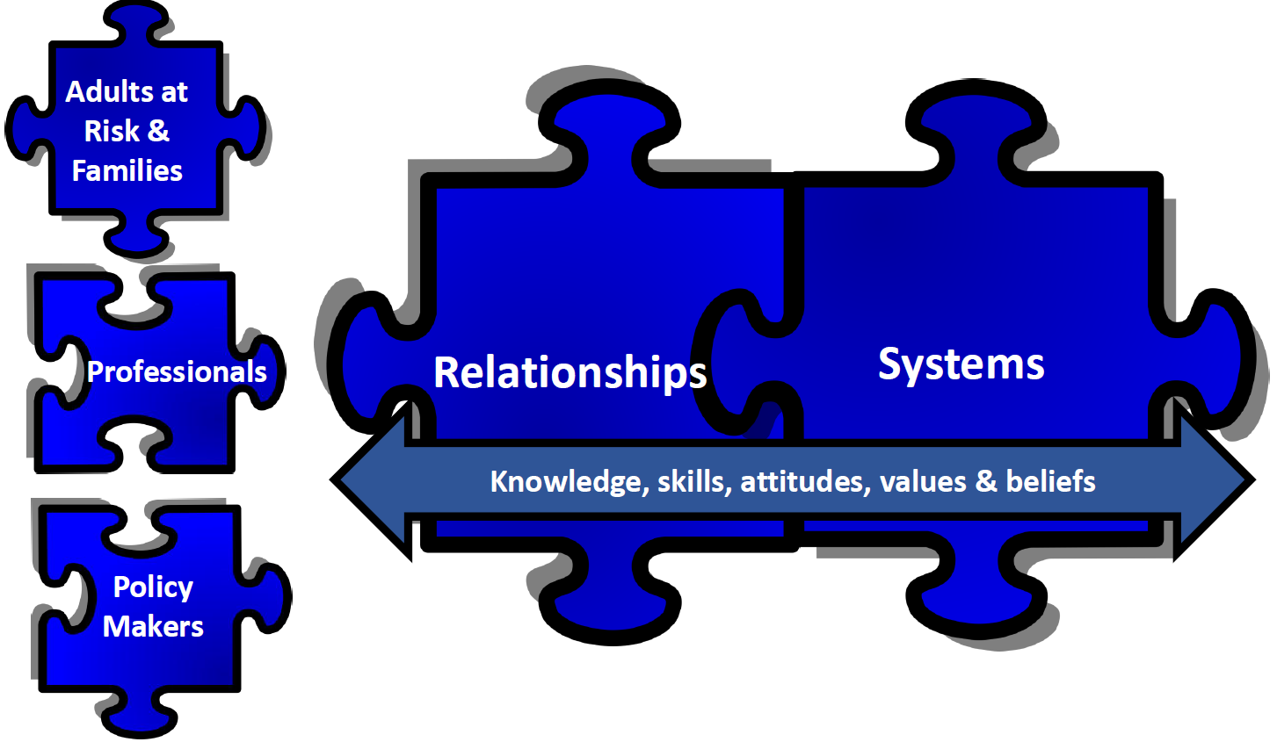
Qualitative Data-Interviews
In a nutshell the use of SGA is the way forward without any other funding or guidance but you need to have the right resources for it to be effective-these are
At all levels working in harmony with each other i.e. for adults at risk and families, professionals and policy makers to aim for effective risk reduction. We use normalisation processing theory as a way other areas could embed this learning into practice in their areas.
Notes:
So what did the interviews show
SGA process is respected and fund to be useful but in order to gain risk reduction the process is not enough in itself. For it to work on adult exploitation or other high risk complex cases we need all these 4 resources working concurrently at all levels.
Knowledge- understanding coercion, processes, fear, legislation, consent, MCA-complex area, specialist workers, training, staff wellbeing, learn from SARS
Skills- risk assess, engage, pick up on underlying vulnerabilities
Attitudes- victim blaming-judgements, professional curiosity
Relationships- networks share the load, validate, want to attitude, support, family support, TRUST, authentic, collective voice, allies, political buy in
Systems –gatekeeping. Don’t work CJS. Need infrastructure in place, prevention, early intervention, strategic oversight-SGA BOard driver, be organisationally brave, creative, traua informed, remove support tonquickly, intelligence gathering, governance

Slide 15
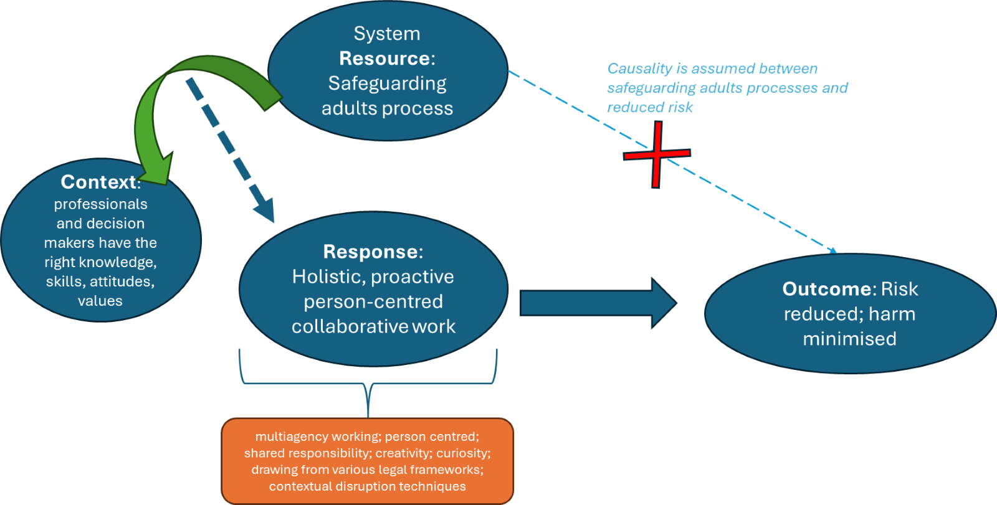
Overarching programme theory diagram
Notes:
Figure 1 highlights the widespread assumption that the statutory duty of safeguarding adult procedures and associated legal frameworks is sufficient to lead to risk being managed or minimised for A@R. In this paper, we highlight that this belief is erroneous, and that the right contextual conditions need to be in place in order to enable this to happen. These are linked to the development of knowledge, skills, attitudes values and beliefs across the whole system, so that a proactive, bespoke and response can be triggered.
Safeguarding adult procedures is a widely used framework across England that is not being used consistently for A@R of exploitation, because people are not seen as meeting the criteria, or not seen as being abused. The key learning from this research is that in order for the governance structures, policies and procedures to work more systematically, the right contextual conditions need to be developed concurrently.

Slide 16
Normalisation Process Theory
Coherence
Cognitive Participation
Collective Action
Reflexive Monitoring
Notes:
Coherence refers to all involved making sense of the Safeguarding Adults Processes, how different it is from prior work and its underlying values. This study has highlighted the crucial importance of all agencies and professionals involved sharing the same values to ensure that A@R are treated fairly and protected from exploitation. Shared understanding of the impact of trauma, control and coercion, and the concept of capacity in the context of pre-existing vulnerabilities and subsequent exploitation is key.
Cognitive participation relates to the fact that all professionals need to understand their particular, and collective role within adult exploitation. They need to have lasting and trusting relationships within and beyond their organisations, to establish together that there is an exploitative relationship and decide how best to proceed. Each professional and agency needs to have an in-depth knowledge of their own criteria and organisational ethos, and challenge these when there is a risk that an A@R may be left unsupported. Making adult exploitation a priority across all agencies is crucial.
Collective action relates to the operational practices that are put in place following the previous step. This collaborative endeavour needs to happen between A@R and professionals, between different agencies, and at policy level, for the safeguarding A@R processes to be implemented consistently and successfully. Collective action requires professionals and systems to be creative, brave and driven by the ethos of tackling adult exploitation.
Reflexive monitoring relates to the fact that with such a complex set of organisational requirements, and complex exploitative situations, the system needs to be constantly learning to respond to new exploitative practices as they happen, in a cohesive way. Systematic data collection and sharing is key for this, as is the leadership drive for continuous learning and improvement.

Slide 17
Conclusion
The use and implementation of safeguarding adult processes is variable nationally, but was widely respected and valued in Newcastle as a way to ensure Robust MDT working and MSP.
Our research is the first to show, through thorough data collection and rigorous data analysis, the conditions necessary to enable them to be used effectively. The safeguarding process allows a central point of coordination, ensuring all agencies cooperate but works best when the right knowledge, skills attitudes values and beliefs, relationships are embedded at all levels of the system. This helps all agencies to understand their roles and duties to disrupt the exploitative activities.
Adults experiencing exploitation face many barriers, often have multiple co-occurring vulnerabilities that perpetrators know how to target to get control, often have care or support needs, which can be missed by agencies.
This is compounded by heavy workloads and victim blaming attitudes or a lack of appreciation of the impact of coercion and substance use on how people present themselves. This is especially relevant in times of austerity and shrinking budgets, which leaves adults at significant risk of harm and perpetrators largely undisturbed.
Whilst there are gaps in legislation and policy, there are processes that can be utilised to ensure a coordinated response to try to manage risks, ensure communities and people are safer and ensuring accountability that each agency is fulfilling its roles and statutory powers.

Slide 18
Contact details
Kerry.cooke@newcastle.gov.uk
monique.lhussier@northumbria.ac.uk
Homepage - Newcastle Safeguarding
Resources for Practice - Newcastle Safeguarding
Full weblink: https://www.newcastlesafeguarding.org.uk/external-resources/#jigsaw

